Slide 1

LIST OF WORLD’S BILLIONAIRES

Slide 2
Introduction: Here is a brief introduction of dataset that we are using.
List of World’s Billionaires
Business, industry and personal information
Net worth in USD
Age and country of residence
Self-made or inherited
Full name, DOB and Gender
Populations of the country
GDP and CPI of the country
Tax revenue and tax rate

Slide 3
Dataset Description:
This dataset contains statistics on the world's billionaires, including information about their businesses, industries, and personal details. It provides insights into the wealth distribution, business sectors, and demographics of billionaires worldwide.

Slide 4
Analysis Tasks: We defined some tasks for performing EDA upon provided dataset.
What are the most common industries and sources of wealth among billionaires?
Analyze Top Sources of Wealth
How is billionaire wealth distributed across countries and regions
Total and Average Wealth by Country
How does age and gender relate to billionaire status or wealth accumulation

Slide 5
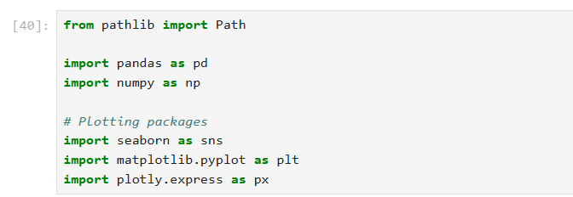
Importing libraries: We will import necessary libraries for preforming our analysis.

Slide 6
Loading dataset: Loading the dataset using read_csv function from pandas library.

Slide 7
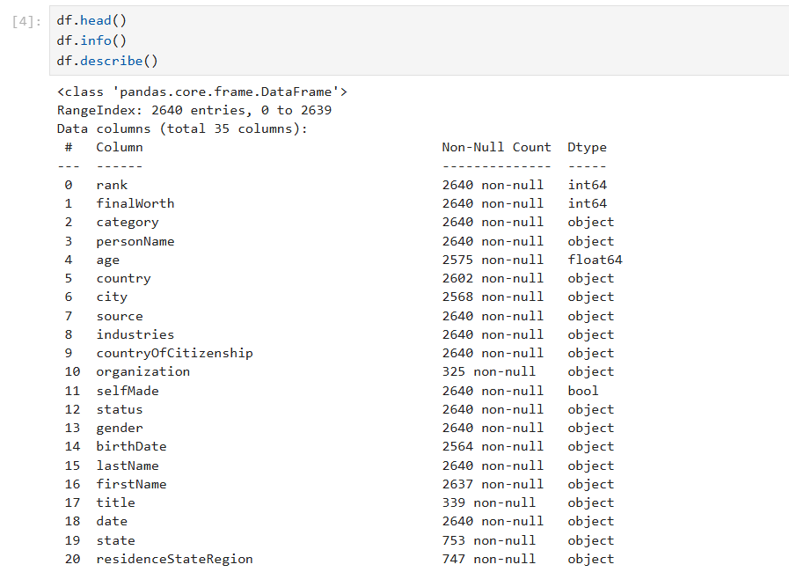
Performing analysis on data for understanding dataset using certain built-in functions.

Slide 8
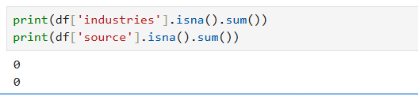
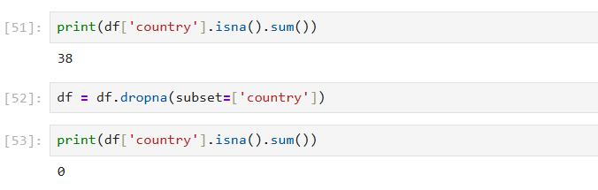
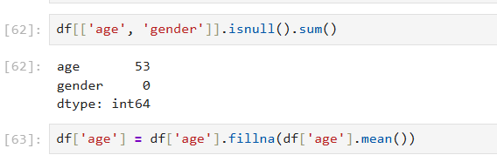
Data Cleaning and formatting: Check for null values.
After finding some null values we handled them using different techniques depending upon the requirement.
Like in “country” column we dropped them because we cannot assign different country name to corresponding data.
In “age” column we replaced null values with average age.

Slide 9
Data formatting:
We performed some formatting steps to achieve the required task goals.
Using “groupby” function we are generating a summary statistics table by country.
And in the second one we are doing a gender-based summary of billionaire net worth.

Slide 10
Data visualization: Create different visualizations for each of the sub questions to gain insights about the data.
We are using different plots here for visualization.
A bar plot in Python is used to display categorical data with rectangular bars, showing comparisons between categories, while a choropleth is used to represent geographic data with different shading or patterns based on the value of a variable.

Slide 11
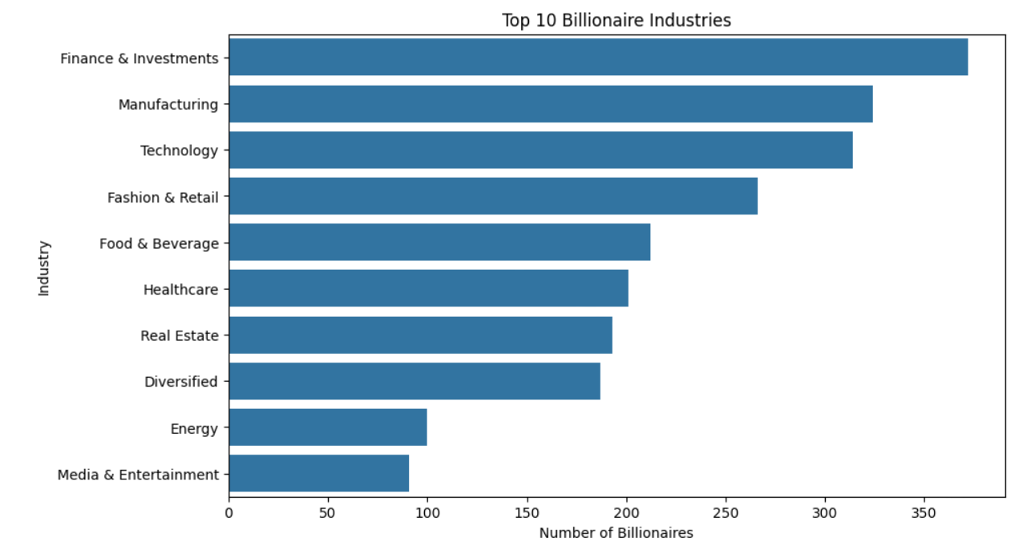
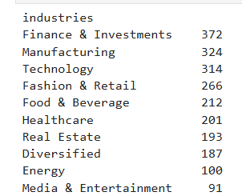
Task#1:What are the most common industries and sources of wealth among billionaires?
“The most common industry among billionaires is Finance & Investments, followed by Manufacturing and Technology.”

Slide 12
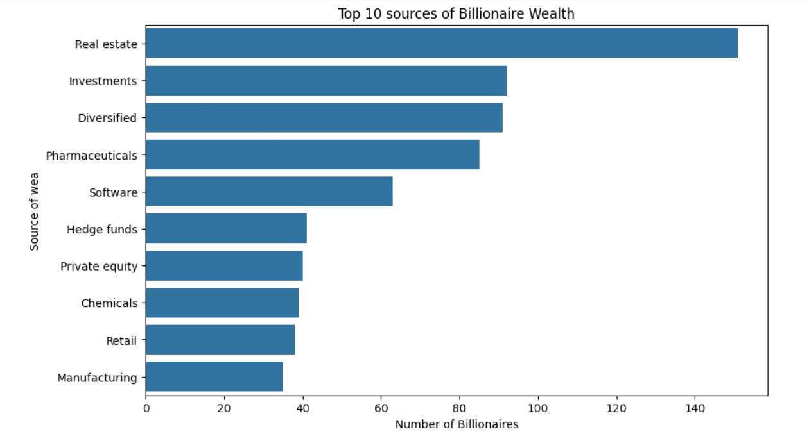
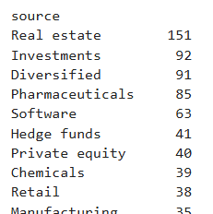
Task#2: Analyze Top Sources of Wealth
“Most billionaire's wealth sources are rooted in real estate followed by investments and on number 3 is diversified and 4 is pharmaceuticals.”

Slide 13
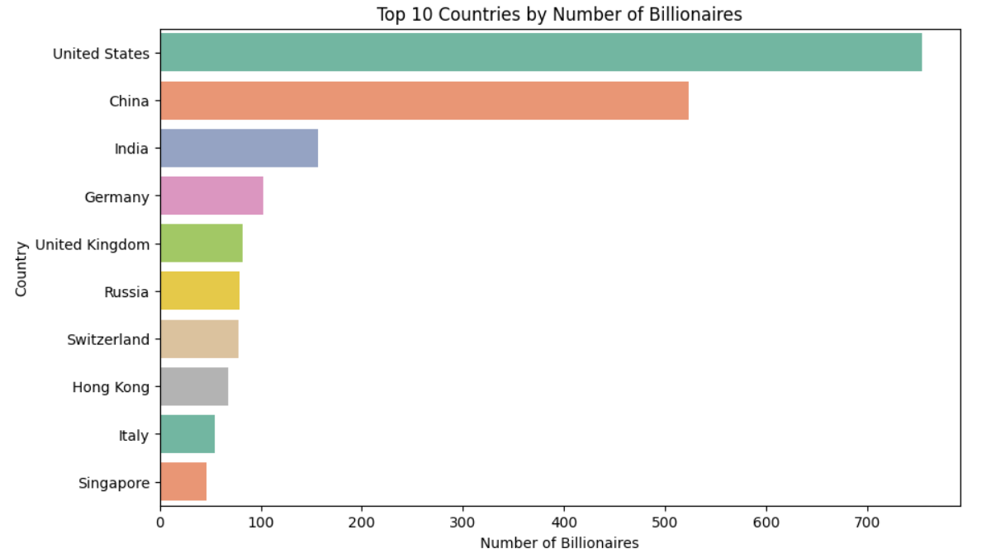
Task#3: How is billionaire wealth distributed across countries and regions?
This question tells us where wealth is concentrated globally, helping us understand economic centers of billionaire activity.
The bar chart categorizes that United states is on top with 754 billionaires followed by China 523 billionaires from whole world which shows that more than 60% of world billionaires are from these two countries only.

Slide 14
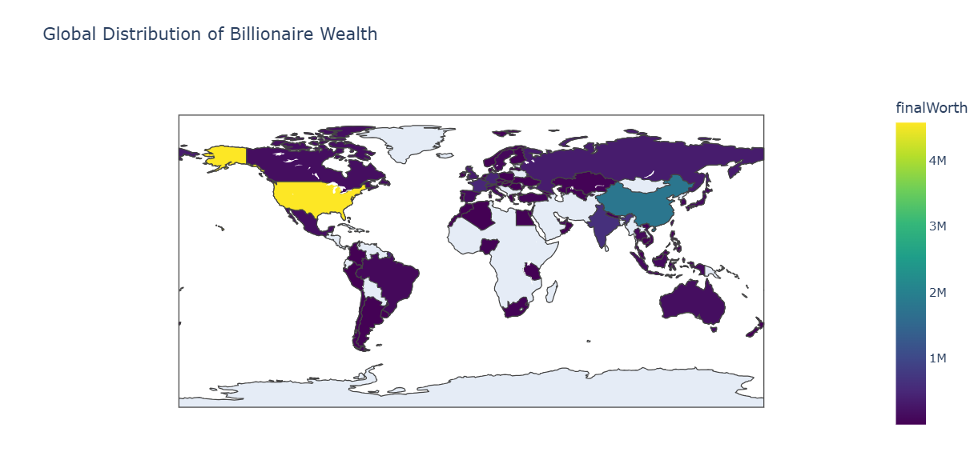
Task#4: Total and Average Wealth by Country
The USA leads with the most billionaires, followed by China and India. Although the USA has the most billionaires, France shows one of the highest average billionaire net worths which is 14271.428571, indicating a high concentration of wealth per individual, on second is USA with value 6067.771883 and on number 3 is Switzerland with value 5255.128205.

Slide 15
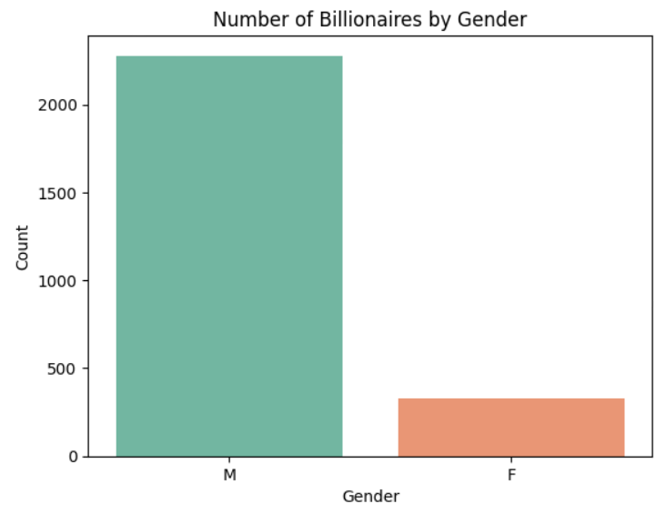
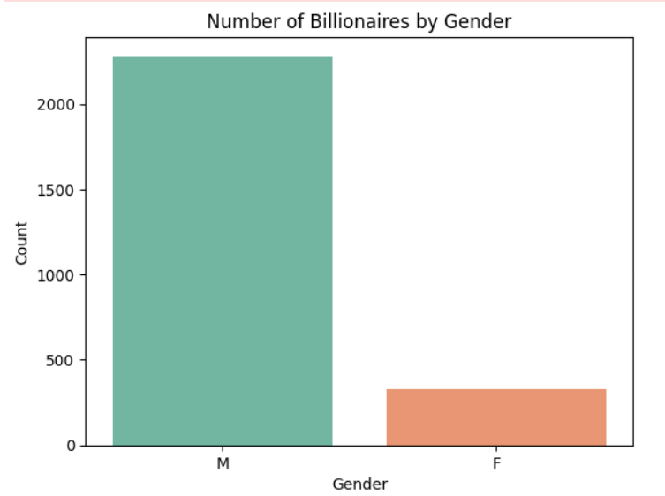
Task#5: How does age and gender relate to billionaire status or wealth accumulation?

Slide 16
Insights:
Although there are more no of male billionaires than female billionares but the average net worth is fairly similar between genders:
male=4.66B and female= 4.63B
And Median is higher for females: $2.5B vs $2.3B
This suggests that the typical female billionaire might be wealthier than the typical male, even though the top male outliers skew the male mean higher.
The wealthiest male is worth $211B.The wealthiest female is worth $80.5B.This shows extreme outliers exist more on the male side, which also increases their average.

Slide 17


